Slide 1
New hotel in Toronto
Coursera – Capstone Project
Chang

Slide 2
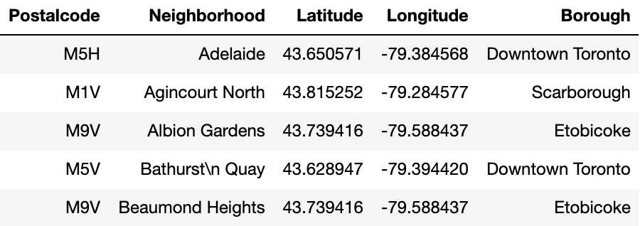

1. Data source
Postal code of Toronto, with neighborhood and borough information: https://en.wikipedia.org/wiki/List_of_postal_codes_of_Canada:_M
Longitude and Latitude of each neighborhood: https://cocl.us/Geospatial_data
Other information about venues and hotels in the neighborhood: Foursquare

Slide 3
2. Factors to consider when selecting a location for hotel
Nearby competition
→ Retrieved from Foursquare
Nearby other venues categories
→ Retreived from Foursquare
Hotel’s target segment, potential facilities to offer
→ According to hotel’s planning

Slide 4
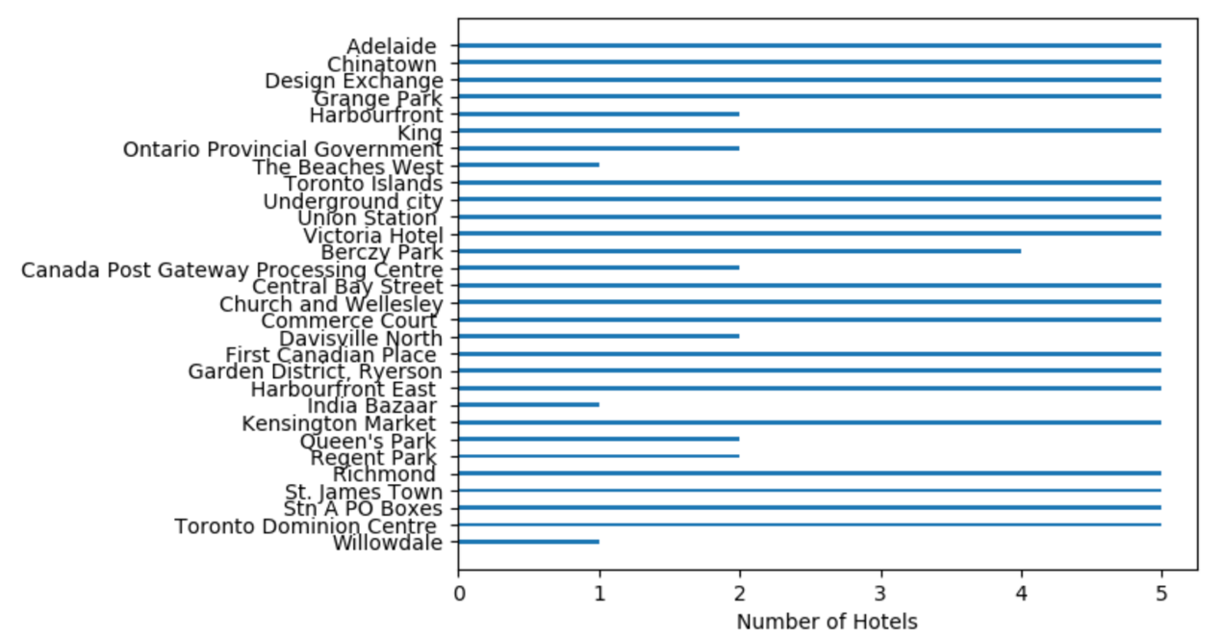
3. Nearby competition
According to the Longitude and Latitude recorded in the data set, I retrieved top 5 hotels within neighborhoods.
Most of neighborhoods reached the limit of 5 hotels, while some of the neighborhood does not contain more than 5 hotels.
Neighborhood with less than 5 hotels are potential neighborhoods for less drastic competition markets.

Slide 5
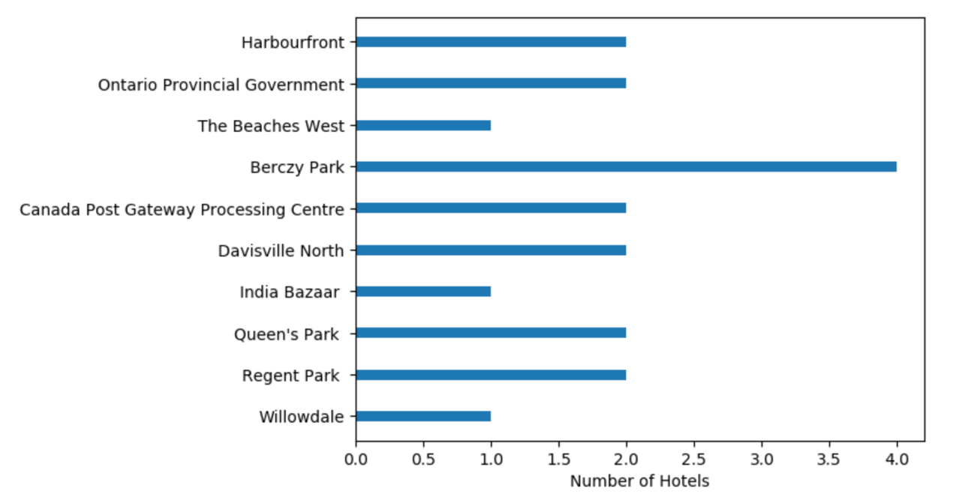
4. Potential choices of neighborhoods
From all the neighborhoods, these are the ones with less than 5 hotels.
These neighborhoods are suitable for starting a new hotel since they are not competitive in the hotel segments, no worries of oversupply.
The next step is to see variety of venues in these neighborhood.

Slide 6
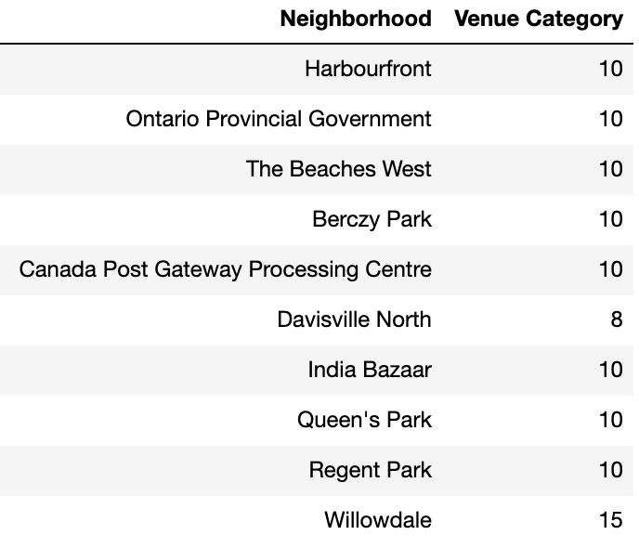
5. Variety of neighborhood venues
Davisville North is the neighborhood with the least various categories of venue
Willowdale has the most various categories

Slide 7
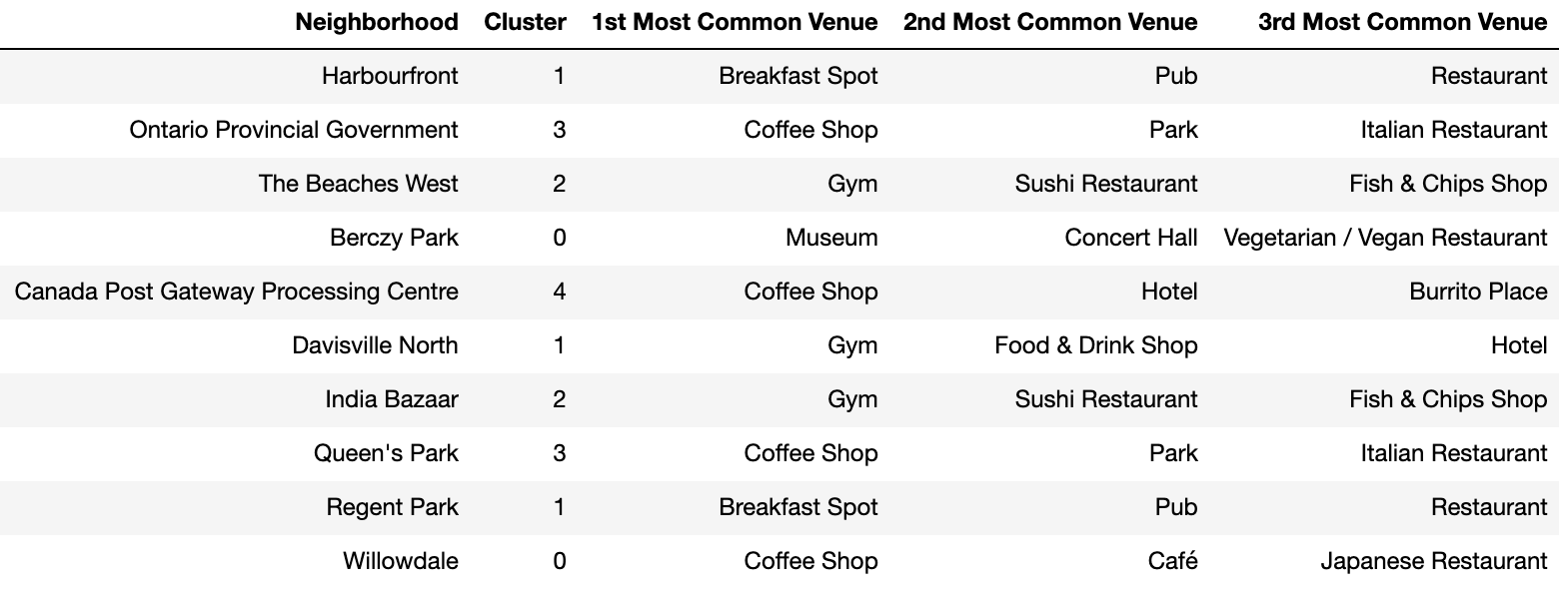
6. Cluster analysis of potential neighborhoods
Then I applied cluster analysis to cluster these neighborhoods in different classes
These cluster represent that related neighborhoods are similar as in the venues they have
Further on investigations shall be implemented

Slide 8
7. Further on investigation
Consider hotel target segments, price range, facilities that are planning to include and real estate information in potential neighborhoods as in clusters to cross check the needs of hotel developers and neighborhood characters.

